Slide 1
Hello Sail，Sail 与 C 互操作
[sail/act 开发入门] sail-riscv (一)

Slide 2

Get Started
仓库: https://github.com/rems-project/sail
安装: https://github.com/rems-project/sail/blob/sail2/INSTALL.md
prebuild binary:
build from source
opam switch create 5.1.0
eval $(opam config env)
sudo apt-get install build-essential libgmp-dev z3 pkg-config zlib1g-dev
make -j$(nproc)
vscode 插件: https://github.com/timmmm/sail_vscode

Slide 3
Hello Sail!
default Order dec
$include <prelude.sail>
function main () : unit -> unit = {
print("Hello Sail!")
}
- 语法参考了 Ocaml (一个函数式编程语言) (Rust 用户友好)
- default Order 语法类似于宏定义 https://github.com/rems-project/sail/blob/sail2/lib/vector.sail
- 标准库位置: https://github.com/rems-project/sail/tree/sail2/lib
- print: https://github.com/rems-project/sail/tree/sail2/lib/sail.h (print 系列函数也参考了 ocaml)

Slide 4
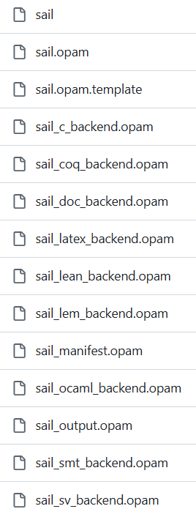
Multi Target
编译 sail 源代码: sail hello.sail
sail --help
0.18.0
usage: sail <options> <file1.sail> ... <fileN.sail> -o <prefix>
-----------------------------------------------------
Options for target c -c invoke the Sail c ... --c-include <filename> provide additional ..
...
Options for target systemverilog
...
Options for target ...

Slide 5
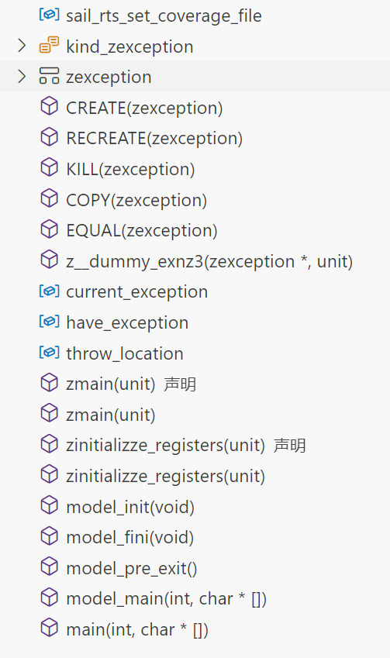
Compile to C
SAIL_FLAGS = --require-version 0.18 # 限制版本
SAIL_FLAGS += --all-modules # 编译所有模块
SAIL_FLAGS += -O -Oconstant_fold # 性能优化
SAIL_FLAGS += -c # 生成 c 源代码
build:
sail $(SAIL_FLAGS) hello.sail -o main

Slide 6
Compile to Binary
build:
$(CC) $(C_FLAGS) -o main $(C_SRCS)
C_FLAGS = -I $(SAIL_LIB_DIR) $(GMP_FLAGS) $(ZLIB_FLAGS)
C_SRCS = $(SAIL_LIB_DIR)/*.c $(GMP_LIBS) $(ZLIB_LIBS) hello.c
# sail-lib
SAIL := sail
SAIL_DIR := $(shell $(SAIL) --dir)
SAIL_LIB_DIR := $(SAIL_DIR)/lib
SAIL_SRC_DIR := $(SAIL_DIR)/src
# The C output requires the GMP library for arbitrary precision arithmetic
GMP_FLAGS = $(shell pkg-config --cflags gmp)
GMP_LIBS = $(shell pkg-config --libs gmp || echo -lgmp)
# zlib for working with compressed ELF binaries.
ZLIB_FLAGS = $(shell pkg-config --cflags zlib)
ZLIB_LIBS = $(shell pkg-config --libs zlib)

Slide 7
zmain is all your need!
int model_main(int argc, char *argv[])
{
model_init();
...
zmain(UNIT);
model_fini();
model_pre_exit();
return EXIT_SUCCESS;
}
int main(int argc, char *argv[])
{
return model_main(argc, argv);
}
unit zmain(unit);
unit zmain(unit zgsz30)
{
__label__ end_function_1, end_block_exception_2;
unit zcbz30;
zcbz30 = print("Hello Sail!");
end_function_1: ;
return zcbz30;
end_block_exception_2: ;
return UNIT;
}

Slide 8
Drop the main
--c-no-main do not generate the main() function --c-no-rts do not include the Sail runtime --c-no-lib do not include the Sail runtime or library
SAIL_FLAGS += --no-main

Slide 9
Call Sail From C
#include "sail.h"
int main() {
zmain(UNIT);
return 0;
}
C_SRCS = $(SAIL_LIB_DIR)/*.c $(GMP_LIBS) $(ZLIB_LIBS) hello.c main.c
build-c-sim:
build-sail-no-main $(CC) $(C_FLAGS) -o main $(C_SRCS)

Slide 10
逆转! Call C from Sail
// lib.h
#include <sail.h>
void add(sail_int *c, sail_int a, sail_int b);
// lib.c
#include "lib.h"
void add(sail_int *c, sail_int a, sail_int b)
{
mpz_add(*c, a, b);
}
# hello.sail
default Order dec
$include <prelude.sail>
val add = pure "add" : (int, int) -> int
function main () : unit -> unit = {
print_int("Hello Sail!", add(1, 2));
}
SAIL_FLAGS += -c_include

Slide 11

参考资料
Sail https://github.com/rems-project/sail
sail-riscv https://github.com/riscv/sail-riscv/

